Slide 1
Making this resource work for you
Prior to teaching this lesson, please refer to the ‘Unit Overview and Planning Document’.
Further guidance on planning Science Mastery lessons can be found in the detailed planning guidance document.
Refer to the ‘notes’ section on each slide for useful information, including suggested expositions, pedagogical content knowledge, suggested questions, answers and more. Consider using presenter mode so you can see this guidance throughout the lesson.
The introduction slides can be adapted to suit your teaching style and the needs of your class.
Before the lesson, adapt the fix-it slide to address any misconceptions identified in the previous lesson’s exit ticket.
Choose from the suggested activities to suit your class. The intention is not that you complete all of these, but that you select those which ones are most appropriate for your students. It may be appropriate to further adapt activities for your students.
These lessons are designed to occupy approximately 1 hour. To adapt for a shorter or longer lesson duration we advise you to adapt the activity section accordingly.
Please consider using the final slide to send feedback about this lesson or examples of PowerPoints that you have adapted to our design team. Your feedback is used to improve Science Mastery for all of our teachers and students. We appreciate all suggestions and comments.
Thank you for reading!
The Science Mastery Team

Slide 2

Ionic Equations and Displacement Reactions
Answer the questions below.
Why do metal atoms generally form positive ions?
What group number are the Noble Gases on the Periodic Table?
What charge do the ions of group 1 elements have?
What charge do the ions of group 7 elements have?
Sodium oxide contains the ions Na⁺ and O²⁻. What is the chemical formula for sodium oxide?
Metal atoms form positive ions because they tend to lose electrons.
The Noble Gases are in group 0 (group 8)
The ions of group 1 elements have a charge of +1
The ions of group 7 elements have a charge of -1.
Na₂O
Notes:
Big idea: Reactions Rearrange Matter
Foundation: Write the electronic configuration of a chlorine atom
Stretch: Write the electronic configuration of a chlorine ion
Answers:
Foundation: 2, 8, 7
Stretch: (2, 8, 8)⁻¹

Slide 3
Ionic Equations and Displacement Reactions
Do Now:
Why do metal atoms generally form positive ions?
What group number are the Noble Gases on the Periodic Table?
What charge do the ions of group 1 elements have?
What charge do the ions of group 7 elements have?
Sodium oxide contains the ions Na⁺ and O²⁻. What is the chemical formula for sodium oxide?
Drill:
Draw the electronic configuration for a sodium atom.
Draw the electronic configuration for a chlorine atom.
Describe in terms of electrons what happens when a sodium atom reacts with a chlorine atom.
Notes:
Answers:
Do Now:
1. Metal atoms form positive ions because they tend to lose electrons.
2. The Noble Gases are in group 0 (group 8)
3. The ions of group 1 elements have a charge of +1
4. The ions of group 7 elements have a charge of -1.
5. Na₂O
Drill:
1. Sodium: 2, 8, 1
2. Chlorine: 2, 8, 7
3. One electron is transferred from the outer shell of the sodium atom to the outer shell of the chlorine atom.

Slide 4
Ionic Equations and Displacement Reactions
Read Now:
Usually, atoms will only give up a small number of electrons in order to form ions. For example, a sodium atom will give up one electron from its outer shell, so that it reaches a more stable electronic arrangement. It is much more difficult to remove another electron from sodium. Scientists are, however, able to remove all of the electrons from some elements! The ions formed in this case are called highly charged ions. Examples of highly charged ions that scientists have made include U⁹²⁺, Xe⁴⁰⁺ and Fe¹³⁺. The positively charged nucleus is attracted to the negatively charged electrons, This means that it becomes harder and harder to remove each electron as the nucleus pulls the remaining electrons more strongly.
How many electrons will a sodium atom give up easily?
From which shell will a sodium atom give up an electron?
What name is given to the particles produced when many electrons are removed from an atom?
State one example of a highly charged ion.
Why is it more difficult to remove each additional electron from an atom?
Notes:
Answers:
1
The outer (valence) shell
highly charged ions
U⁹²⁺
The positively charged nucleus is attracted to the negatively charged electrons. The nucleus has a stronger attraction to electrons that are closer to it (in the inner shells)

Slide 5

C4.2.4
12/12/2024
(HT) Ionic Equations and Displacement Reactions
C4.2.1 PKR: Reactions of Metals
C4.2.2 Extracting Less Reactive Metals
C4.2.3 PKR: Ions, Ionic Bonding and Deducing Ionic Formulae
C4.2.4 (HT) Ionic Equations and Displacement Reactions
C4.2.5 (HT) Writing Half Equations
C4.2.6 (HT) Ionic Equations for the Reactions of Acids and Metals
C4.2.7 Introduction to Electrolysis
C4.2.8 Extracting Metals by Electrolysis
C4.2.9 Electrolysis of Molten Ionic Compounds
C4.2.10 Electrolysis in Solutions
C4.2.11RP: Electrolysis of Aqueous Solutions 1
C4.1.12 RP: Electrolysis of Aqueous Solutions 2
C4.1.13 TIF: Corrosion and its Prevention
C4.2.14 (HT) Obtaining Raw Materials
C4.2.15 Recycling Metals
C4.2.16 Feedback Lesson
Notes:
Big Idea: Reactions Rearrange Matter
Suggested Hook:
What is the difference between a sodium atom and a sodium ion?

Slide 6

Following this lesson, students will be able to:
Write chemical equations in terms of ions
Write ionic equations for displacement reactions
Identify oxidised and reduced species using ionic equations
Key Words:
spectator ions
oxidation
displacement
reduction
Notes:
Guidance:
See unit overview document and planning guidance to see how these objectives are typically assessed at GCSE, including examples of what students should be able to do following this lesson.
Planning for different needs:
The learning objectives given on this slide are suggested based on the most common requirements for exams, however they can be adapted based on the needs of different classes.
For best practice, the unit preparation booklet should be used to determine the appropriate focus of lessons within the unit.
While it is not possible to explicitly split content into levelled grades, we recommend that lesson objectives can be classified as critical, core or stretch.
Critical: the content or skill is essential for all students to be able to progress.
Core: the content or skill is important for students to progress, but other opportunities may be available to revisit it.
Stretch: the content or skill may not be essential for all students but is important for students aiming for the highest grades.
Key skill: this is a crucial skill being developed in this unit as part of the skill mapping
C4.2.4 Lesson Objectives:
Critical: Write chemical equations in terms of ions
Critical: Write ionic equations for displacement reactions
Critical: Identify oxidised and reduced species using ionic equations

Slide 7
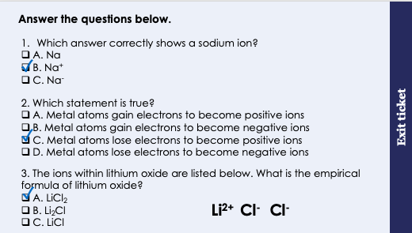
This is the fix-it portion of the lesson
The fix-it is an opportunity to respond to gaps in knowledge, especially those identified by the previous lesson’s exit ticket.
The teacher should customise this slide as needed, to facilitate
reteach, explanation, demonstration or modelling of ideas and concepts that students have not yet grasped or have misunderstood.
practise answering specific questions or of key skills.
redrafting or improving previous work.
Notes:
Fix-it guidance from previous exit ticket:
Q1. Answer: B
If students answer A, they have confused atoms and ions. If students answer C, they might think that losing an electron results in a positively charged ion. To fix-it, remind students of the definition of an ion, with some examples. Show a worked example using electronic configuration diagrams that shows how an atom becomes an ion, and how we can deduce the charge on that ion. Give students some similar questions to try independently.
Q2. Answer: C
If students answer A or B, they do not realise that metal atoms would usually lose electrons. To fix-it, explain why it is that metal atoms lose electrons, and ensure that students can identify metal vs non-metal atoms. If students answer D, they are confused about how the gain or loss of electrons results in positive or negative ions. To fix-it, check that students recall that electrons have a negative charge. Help them to think about the transfer of electrons as the transfer of negative charges, so that getting negative charges results in the ion having a greater negative charge, and losing negative charges results in the ion having less of a negative charge (or more of a positive charge).
Q3. Answer: A
If students answer B, they may be associating the charge of the ions with the subscript number in the empirical formula. To fix-it, work through a similar example question with students, narrating the thinking process along the way. Explain that the number (count) of positive and negative ions is what is used to determine the empirical formula.

Slide 8
(a) Identify the ions present in each of these formulae (b) State how many of each ion is in the formula
NaCl
HCl
Li₂O
4. H₂SO₄
5. Cu(NO₃)₂
1
1
1
2
H⁺ SO₄²⁻
Na⁺ Cl⁻
1
1
H⁺ Cl⁻
1
2
Cu²⁺ NO₃⁻
2
1
Li⁺ O²⁻
(c) Complete the table below.
A | B | Would A need to gain or lose electrons to become B? | How many electrons?
H_{(g)} | H⁺_{(aq)}
Na⁺_{(aq)} | Na_{(s)}
Cl_{2(g)} | 2Cl⁻_{(aq)}
Cu²⁺_{(aq)} | Cu_{(s)}
Mg_{(s)} | Mg²⁺_{(aq)}
lose
1
gain
1
gain
2
gain
2
lose
2
Notes:
Exposition type: Explanation
Students should be secure in answering these questions to be able to access the learning from the rest of this lesson.
Model teacher exposition:
Firstly, I want you to identify the ions that are present in these formulae. You do not need to know ion formulae off by heart – use the list of ions you have been provided.
Do one example on the board first, narrating your thought process out loud.
Next we will write down how many of each ion is needed to make the formula. If there is a subscript number that is in addition to the usual ion formula, that indicates that there is more than one of any type of ion.
So, for K₂O, I know the ions in here are K⁺, another K⁺ and O²⁻
Think back to our lesson on ionic bonding. Why are there 2 potassium ions and only one oxygen ion in this example? Because two potassium ions are needed to neutralise (or cancel out) the oxide ion, which has a charge of 2-.
Looking at the table, I want you to remember that an electron has a negative charge.
So, if a neutral atom (neutral means no charge) gains electrons, it is gaining negative charges, and so it will end up being negatively charged.
It might help to draw the electronic configurations of these ions and imagine electrons being gained or lost, and the resulting charges.

Slide 9
Writing ionic equations
Use your list of ions handout to help!
Look at this chemical equation:
Mg_{(s)} + CuSO_{4(aq)} → MgSO_{4(aq)} + Cu_{(s)}
We can use 2 steps to write this as an ionic equation:
Step 1: Split up the aqueous (aq) substances into their ions
Mg_{(s)} + Cu²⁺_{(aq)} + SO₄²⁻_{(aq)} → Mg²⁺_{(aq)} + SO₄²⁻_{(aq)} + Cu_{(s)}
Step 2: Delete the spectator ions (the ones that appear on both sides)
Mg_{(s)} + Cu²⁺_{(aq)} → Mg²⁺_{(aq)} + Cu_{(s)}
Notes:
Exposition type: Explanation
Model teacher exposition:
We are going to look at how to write ionic equations. These equations will become increasingly important as we work through this unit, so we want to ensure you are secure in writing these.
We can start with a regular chemical equation.
Just like we did earlier in the lesson, let’s first break up any of the aqueous substances into their ions – that’s step 1.
Use the list of ions that you have been provided to check the charges on each ion carefully, and make sure the state symbols are written.
When we break up an aqueous substance into its ions, each of those will also be aqueous, so just keep the same state symbol.
Now, look on each side of the equation (each side of the arrow).
Are there any species that are exactly the same on each side? Yes
These are called the spectator ions, and we don’t want these in our final equation. So I’m going to rewrite the equation without these.
Our final result is an ionic equation.

Slide 10
What does an ionic equation show?
Mg_{(s)}
+ Cu²⁺_{(aq)}
→
Mg²⁺_{(aq)}
+ Cu_{(s)}
Magnesium atoms lose 2 electrons to become positively charged ions
This loss of electrons is called oxidation
Oxidation is the loss of electrons
Copper ions gain 2 electrons to become neutral atoms
This gain of electrons is called reduction
Reduction is the gain of electrons
A redox reaction is one in which oxidation and reduction take place at the same time
Notes:
Exposition type: Explanation
Model teacher exposition:
Ionic equations actually tell us quite a bit about what happens in a reaction.
Look at the same element on each side of the arrow (on each side of the equation), and think about what has changed.
Let’s take Magnesium.
It’s starts out as a neutral magnesium atom. At the end, it’s a positively charged ion.
So what has happened to magnesium in this reaction? It has lost electrons.
When something loses electrons we can call this oxidation. You have already come across this word before but we had a different definition for it.
Can you remember the other definition of oxidation? Oxidation is the gain of oxygen.
So you see we have two definitions for oxidation, and we will use both these at different times. The definition we have introduced today, that oxidation is the loss of electrons, is the one we always use when talking about ionic equations. You might be asked to define oxidation ‘in terms of electrons’, and then you will know that this is the definition you need.
Now let’s look at copper.
It starts out as a positive copper ion, and by the end of the reaction it is a neutral copper atom.
So what has happened to copper in this reaction? It has gained electrons.
When something gains electrons we can call this reduction. You have already come across this word too, but we had a different definition for it.
Can you remember the other definition of reduction? Reduction is the loss of oxygen.
Just like oxidation we have 2 different definitions for reduction.
To help you remember, we can use the pneumonic OIL RIG, which stands for Oxidation Is Loss (of electrons), Reduction Is Gain (of electrons).
You may want to return to slide 8 and ask students to state whether each row in the table is an example of oxidation or reduction.

Slide 11
With your partner, write an ionic equation for the chemical reaction below.
2Na_{(s)} + CaO_{(aq)} → Na₂O_{(aq)} + Ca_{(s)}
2Na_{(s)} + Ca²⁺_{(aq)} + O²⁻_{(aq)} → 2Na⁺_{(aq)}+ O²⁻_{(aq)} + Ca_{(s)}
2Na_{(s)} + Ca²⁺_{(aq)} → 2Na⁺_{(aq)}+ Ca_{(s)}
Discuss which species is oxidised and which is reduced.
Sodium is oxidised because it loses electrons
Calcium is reduced because it gains electrons
Notes:
Suggested guidance:
Talk tasks can be used in a variety of ways to suit the particular needs of the students you are teaching. Through exchanging views with others, students develop their understanding of the science beyond what could be achieved individually.
Science classrooms that successfully integrate talk have the following features:
Science talk is a regular feature of lessons and is woven into classroom activities.
Students are paired or grouped strategically by the teacher to ensure productive interaction. This might take into consideration the students’ proficiency of the English language, how encouraging they might be to peers and their attainment in the topic. It’s a good idea to consider these pairings in the class seating plan.
Students are encouraged and supported to talk, but are not forced to talk.
The teacher should take on the role of a facilitator, engaging with conversations where necessary and encouraging or steering the conversation where needed.
Students are encouraged to use the language they have to express their ideas (e.g., everyday language, imperfect English, native language), but also to incorporate science specific terminology where this is more accurate or has been taught.
6. Scientifically inaccurate ideas are not dismissed by the partner or teacher; open discussion and further investigation are relied on to help students construct ideas that support them to progress in their scientific understanding.
7. Guidelines for behaviour during talk tasks are explicit and frequently reviewed. Rules for students might be:
Listen carefully to your partner
Take turns talking.
Speak one at a time, without interrupting.
Politely agree or disagree and explain why.
Politely point out if your partner has used a scientific word incorrectly, if they have explained the science incorrectly, or if there is a more accurate way to describe something.
If confused, ask questions.
Stay focused on the discussion topic.
Respond to one another.

Slide 12
Drill
Use your list of ions handout to help!
Define oxidation in terms of electrons
Define reduction in terms of electrons
List the ions that make up LiOH
List the ions that make up Na₂O
What must happen to Fe²⁺ to turn it into Fe?
What is a redox reaction?
Write an ionic equation for the following reaction:
Zn_{(s)} + CuCl_{2(aq)} → ZnCl_{2(aq)} + Cu_{(s)}
8. Write the down the spectator ion in question 7
9. State which species is oxidised in question 7
10. State which species is reduced in question 7
Notes:
Purpose: This is a knowledge drill. The purpose of this is to check that the critical knowledge is secure before pupils move onto independent practice.
Suggested guidance: There are a range of ways this could be done depending on time and ability range of the class:
Mini whiteboards
As full sentences in exercise books
As short answers in exercise books
In the pupil workbook
As pair talk
As cold call

Slide 13
Drill answers
Oxidation is the loss of electrons
Reduction is the gain of electrons
Li⁺ OH⁻
Na⁺ O²⁻
Fe²⁺ must gain 2 electrons to become Fe
A redox reaction is one in which oxidation and reduction take place at the same time
Zn_{(s)} + Cu²⁺_{(aq)} → Zn²⁺_{(aq)} + Cu_{(s)}
2Cl⁻_{(aq)}
Zinc is oxidised because it loses electrons
Copper is reduced because it gains electrons
Notes:
Purpose: This is a knowledge drill. The purpose of this is to check that the critical knowledge is secure before pupils move onto independent practice.
Suggested guidance: There are a range of ways this could be done depending on time and ability range of the class:
Mini whiteboards
As full sentences in exercise books
As short answers in exercise books
In the pupil workbook
As pair talk
As cold call

Slide 14
I: Writing ionic equations
The equation for the reaction between zinc and hydrochloric acid is as follows:
Zn_{(s)} + 2HCl _{(aq)} → H_{2(g)} + ZnCl_{2 (aq)}
1. Write an ionic equation for this reaction
Zn_{(s)} + 2H⁺_{(aq)} → H_{2(g)} + Zn²⁺_{(aq)}
2. Explain which species is reduced in this reaction.
Hydrogen is reduced in this reaction because it gains electrons
Notes:
Purpose: The I-We-You section aims to support pupils to build skills that they most commonly need when answering questions associated with this knowledge in the assessment. This section is also used to interleave other content we expect pupils to know at this stage of their education in order that they build a big picture of the science they are learning.
For the ‘I’ activity, the teacher should model how to answer the question. They can do this by narrating their thinking process aloud, and making links to learning earlier in the lesson explicit.
For the ‘we’ activity, the teacher and students work though a similar example together, in order to prepare students to be able to answer a similar question independently.
Opportunities for the ‘you’ activity – independent practise – occur in the activity portion of the lesson once the student is secure enough to process independently.

Slide 15
We: Writing ionic equations
The equation for the displacement reaction between copper and silver nitrate is as follows:
Cu + 2AgNO₃ → 2Ag + Cu(NO₃)₂
1. Write an ionic equation for this reaction
Cu_{(s)} + 2Ag⁺_{(aq)} → 2Ag + Cu²⁺_{(aq)}
2. Explain which species is oxidised in this reaction.
Copper is oxidised because it loses electrons
Notes:
Purpose: The I-We-You section aims to support pupils to build skills that they most commonly need when answering questions associated with this knowledge in the assessment. This section is also used to interleave other content we expect pupils to know at this stage of their education in order that they build a big picture of the science they are learning.
For the ‘I’ activity, the teacher should model how to answer the question. They can do this by narrating their thinking process aloud, and making links to learning earlier in the lesson explicit.
For the ‘we’ activity, the teacher and students work though a similar example together, in order to prepare students to be able to answer a similar question independently.
Opportunities for the ‘you’ activity – independent practise – occur in the activity portion of the lesson once the student is secure enough to process independently.

Slide 16
You: Writing ionic equations
The equation for the displacement reaction between potassium and copper nitrate is as follows:
2K_{(s)} + Cu(NO₃)_{2(aq)} → 2KNO_{3(aq)} + Cu_{(s)}
1. Write an ionic equation for this reaction
2K_{(s)} + Cu²⁺_{(aq)} → 2K⁺_{(aq)} + Cu_{(s)}
2. Explain which species is oxidised in this reaction.
Potassium is oxidised because it loses electrons
Notes:
Purpose: The I-We-You section aims to support pupils to build skills that they most commonly need when answering questions associated with this knowledge in the assessment. This section is also used to interleave other content we expect pupils to know at this stage of their education in order that they build a big picture of the science they are learning.
For the ‘I’ activity, the teacher should model how to answer the question. They can do this by narrating their thinking process aloud, and making links to learning earlier in the lesson explicit.
For the ‘we’ activity, the teacher and students work though a similar example together, in order to prepare students to be able to answer a similar question independently.
Opportunities for the ‘you’ activity – independent practise – occur in the activity portion of the lesson once the student is secure enough to process independently.

Slide 17
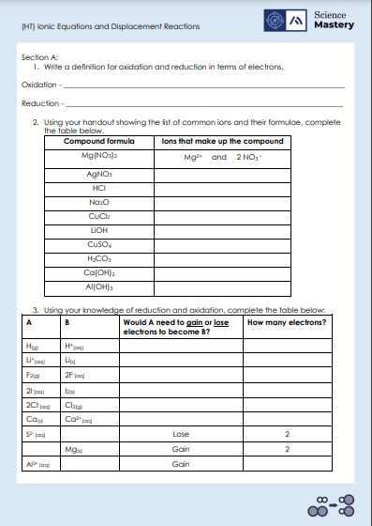
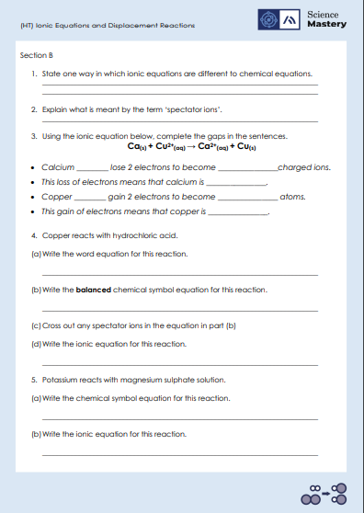
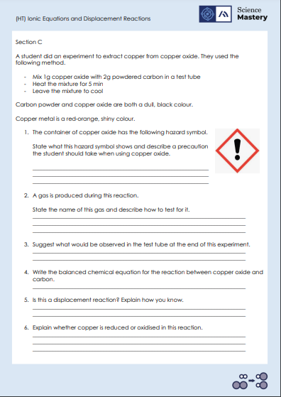
Activity

Slide 18
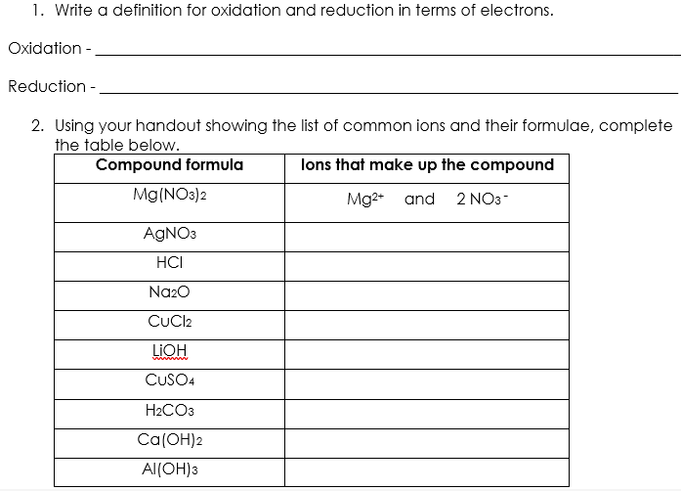
Answers – Section A
is the loss of electrons.
is the gain of electrons.
Ag⁺ and NO₃⁻
H⁺ and Cl⁻
2 Na⁺ and O²⁻
Cu²⁺ and 2 Cl⁻
Li⁺ and OH⁻
Cu²⁺ and SO₄²⁻
2 H⁺ and CO₃²⁻
Ca²⁺ and 2 OH⁻
Al³⁺ and 3 OH⁻

Slide 19
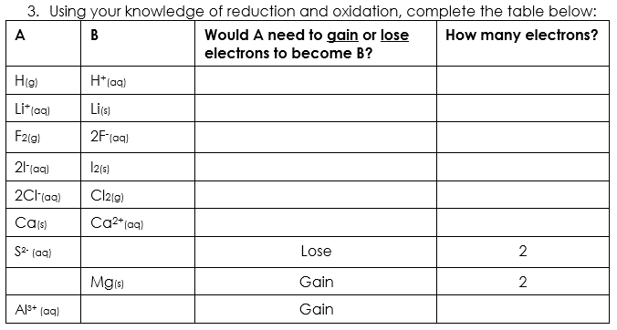
Answers – Section A
Lose
1
Gain
1
Gain
2
Lose
2
Lose
2
Lose
2
S_{(s)}
Mg²⁺_{(aq)}
Al_{(s)}
3
Notes:
Alternative answer for bottom row: could be Al²⁺ when one electron is gained, or Al⁺ when two electrons are gained.

Slide 20
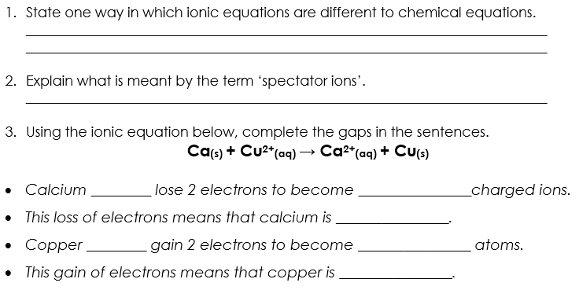
Answers – Section B
Spectator ions are removed in ionic equations but not in chemical equations. Charges on ions are shown in ionic equations but not in chemical equations.
Ions that are the same in the reactants and the products.
atoms
positively
oxidised
ions
neutral
reduced

Slide 21
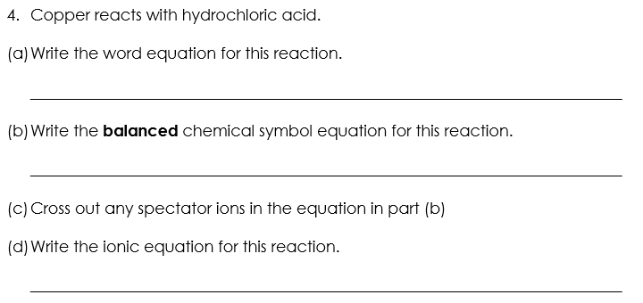
Answers – Section B
Copper + hydrochloric acid → copper chloride + hydrogen
X
X
Cu_{(s)} + 2HCl_{(aq)} → CuCl_{2 (aq)} + H_{2(g)}
Cu_{(s)} + 2H⁺_{(aq)} → Cu²⁺_{(aq)} + H_{2(g)}

Slide 22
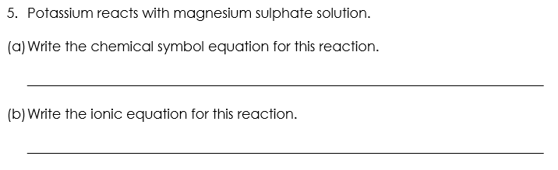
Answers – Section B
X
X
2K_{(s)} + MgSO_{4(aq)} → K₂SO_{4(aq)} + Mg_{(s)}
2K_{(s)} + Mg²⁺_{(aq)} → 2K⁺_{(aq)} + Mg_{(s)}

Slide 23
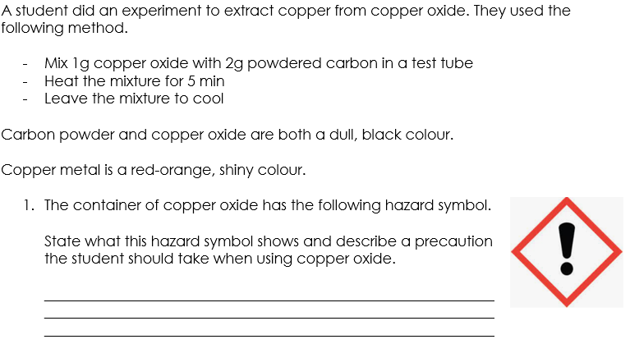
Answers – Section C
Harmful. The precautions the student should take is to wear goggles and wash hands immediately if the copper oxide touches skin.
Notes:
Alternative answers – accept any reasonable precaution that would prevent the copper oxide touching the skin or eyes.

Slide 24
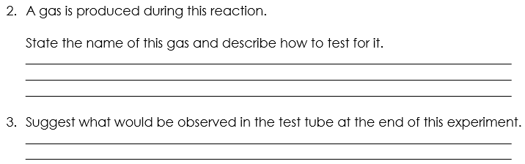
Answers – Section C
Carbon dioxide is produced. To test for the presence of carbon dioxide, the gas should be bubbled through lime water/calcium hydroxide solution, and it changes colour from clear to cloudy.
Solid copper metal, which is a red-orange shiny colour, would be observed.
Notes:
Alternative answers – accept any reasonable precaution that would prevent the copper oxide touching the skin or eyes.

Slide 25
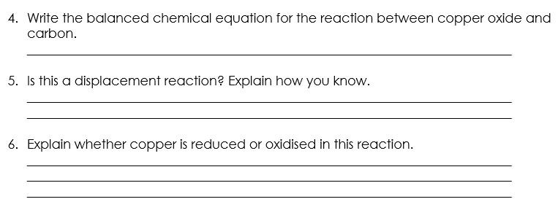
Answers – Section C
2CuO_{(s)} + C_{(s)} → 2Cu _{(s)} + CO_{2(g)}
Yes – because carbon is a more reactive element than copper, so it displaces it and reacts with oxygen.
Copper is reduced because it gains electrons. It starts as Cu²⁺ in copper oxide and then becomes neutral copper atoms.
Notes:
Alternative answers – accept any reasonable precaution that would prevent the copper oxide touching the skin or eyes.

Slide 26
Answer the questions below.
Define reduction.
A. Reduction is the loss of oxygen or the gain of electrons
B. Reduction is the loss of oxygen or the loss of electrons
C. Reduction is the gain of oxygen or the gain of electrons
D. Reduction is the gain of oxygen or the loss of electrons.
✓
2. Magnesium reacts with copper (II) sulfate in a displacement reaction. The chemical equation for this reaction is Mg(s) + CuSO₄(aq) -> MgSO₄(aq) + Cu(s). What is the ionic equation for this reaction?
A. Mg(s) + Cu²⁺⁽aq) + SO₄²⁻(aq)-> Mg²⁺⁽aq) + SO₄²⁻(aq)+ Cu(s)
B. Mg(s) + Cu²⁺⁽aq) → Mg²⁺(aq) + Cu(s)
C. 2Mg(s) + Cu²⁺⁽aq) → Mg²⁺(aq) + 2Cu(s)
✓
Notes:
Q1. Answer: A
If students answer B or D, they think that reduction is the loss of electrons. To fix-it, use OIL RIG to help students remember that oxidation is the loss of electrons and reduction is the gain of electrons.
If students answer C, they think that reduction is the gain of oxygen. They might be mis-using the OIL RIG (thinking it refers to reduction as gaining oxygen instead of reduction gaining electrons). To fix-it, remind students that the word oxidation starts with ‘ox’ because it involves the gain of oxygen.
Q2. Answer: B
If students answer A, they have successfully written each part of the chemical equation as ions, however they have forgotten to remove the species that appear on both sides of the equation (in this case the sulfate ion). To fix-it, remind students that any species that appears in exactly the same way on both sides of the equation is not included in the final ionic equation. Give students more practice in writing ionic equations.
If students answer C, they have included the correct species in their ionic equation, however they have made the common error of trying to balance this equation. Students sometimes mistakenly treat the ion charges as if they were subscript numbers or coefficients. To fix-it, remind students that the charges are not indicative of the number of ions. Give students more practice in writing ionic equations.

Slide 27
Answer the questions below.
3. Sodium atoms are sometimes oxidised to become positively charged sodium ions. Why is this an oxidation reaction?
A. Because oxygen is added to the sodium atoms
B. Because oxygen is lost from the sodium atoms
C. Because the sodium atoms lose electrons to become positively charged
D. Because the sodium atoms gain electrons to become positively charged
✓
Notes:
Q3. Answer: C
If students answer A, they are taking the term oxidation in this case to mean the addition of oxygen, and have not considered (or do not know) what oxidation means in term of electrons. To fix-it, remind students that where oxidation results in ions becoming charged, that the question is referring to the loss of electrons (and not the gain of oxygen).
If students answer B, they are taking the term oxidation in this case to mean the removal of oxygen. This means they both do not understand that oxidation is the addition of oxygen, and they have not considered that this question requires a consideration of oxidation in terms of electrons. To fix-it, remind students of the definition of oxidation in terms of oxygen, and in terms of electrons. Remind students that where oxidation results in ions becoming charged, that the question is referring to the loss of electrons.
If students answer D, they correctly recognise that the question is referring to oxidation in terms of electrons (and not in terms of the gain or loss of oxygen). However, the student thinks that gaining electrons results in a positive charge. To fix-it, remind students that electrons have a negative charge. Therefore, the gain of electrons will result in negatively charged ions.

Slide 28
Lesson C4.2.4
What was good about this lesson? | What can we do to improve this lesson?
Send us your feedback by clicking this link
or by emailing sciencemastery@arkonline.org
Thank you!

